Slide 1
VIRAT KOHLI
BIOGRAPHY

Slide 2
VIRAT KOHLI
Virat kohli is an Indian cricketer and he is the greatest cricketer of all time he was born in delhi india his debut year was 2008 he is a batsman and he is famous because of his legendary innings and his match winning knocks that’s why people also called him KING KOHLI

Slide 3
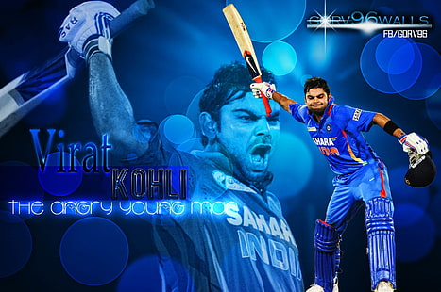

VIRAT KOHLI

